Slide 1

...
LOADING

Slide 2
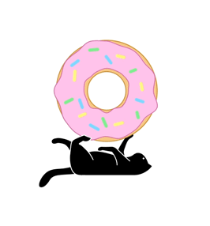
Welcome

Slide 3


Loading Screen Redesign
Our Team
Avula Sneya Driti
(221701008)
Ishwarya
(221701021)

Slide 4
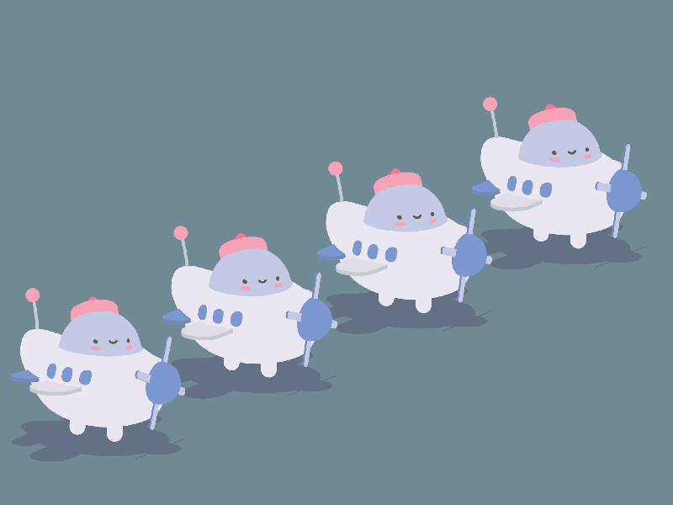
Abstract
LOADING
Let’s face it—waiting sucks. Whether you're waiting for a page to load or an app to update, it can feel like time has come to a screeching halt.
This project is here to spice up those awkward moments with loading screen animations. We’ll explore various types of animations that keep users entertained, distracted, and maybe even amused while their data is loading. Through testing, we’ll figure out which animation style is the best at making waiting feel like it’s just part of the experience, instead of something you just have to “deal with.”
So, buckle up for a smooth, fun journey through the world of loading screens, with minimal frustration and maximum entertainment.

Slide 5
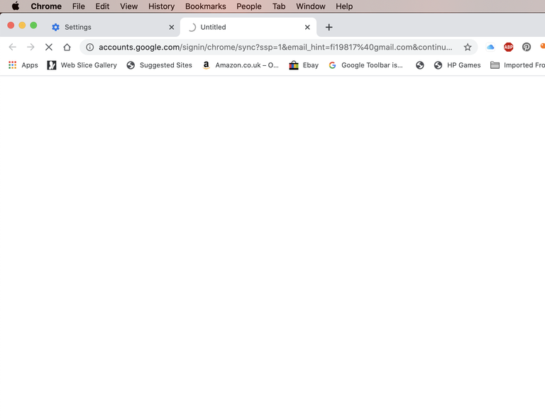
Introduction
Loading screens – the necessary evil of the digital world. Whether you’re waiting for a website to load or an app to start, the familiar spinning circle or progress bar is there to remind you that patience is a virtue. But what if we told you that waiting doesn’t have to be a soul-crushing experience?
In this project, we’ll explore the magic of loading screen animations: the delightful little distractions that keep you from staring at a blank screen, contemplating the meaning of life. Our goal is to design loading screens that not only make you forget you’re waiting but also make you enjoy the experience. Because hey, if you have to wait, it might as well be fun, right?

Slide 6
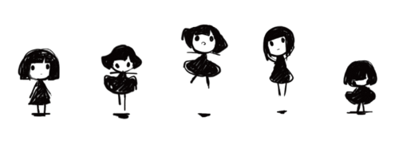
Objectives
To improve the user experience by making loading screens more engaging.
To reduce perceived waiting times with the use of animations and interactive elements.
To create customizable and context-aware loading screen designs.
To explore and implement modern animation tools and technologies.
To evaluate the impact of animated loading screens on user satisfaction and retention.

Slide 7
Literature Survey
Paper | Methods Used | Advantages | Disadvantages | How Our Company Can Overcome These
"The Effects of Mobile Applications’ Passive and Interactive Loading Screen Types" (2024) | Comparing passive vs. interactive screens | Interactive screens improve satisfaction and reduce wait time. | Passive screens lead to poor user experience. | Our company can create interactive loading screens with animations to improve experience.
"Enhancing User Engagement: The Role of Gamification in Mobile Apps" (2021) | Review of gamification in apps | Gamification boosts engagement and app ratings. | Can cause user fatigue if overused. | We can add fun, gamified elements to loading screens to keep users engaged.
"Exploring the Long-Term User Experience of an Interactive Loading Screen" (2024) | UX testing and user feedback | Interactive screens provide long-term positive experiences if updated. | Screens may become boring if not updated. | We can regularly update interactive loading screens to keep them fresh and engaging.

Slide 8

Our References
Animations that match a company’s style improve brand recognition.
Myntra makes waiting feel like a shopping spree, with animations that distract you from the fact you’re stuck loading.
Duolingo’s green owl? It’s basically a hyperactive tutor making sure you never forget it’s there while you wait.
Google Doodles? Interactive fun while you wait—because who needs a boring loading bar? Assassin’s Creed uses loading screens to give you tips or mini-games, so you can feel like a pro while you wait.
Even Amazon’s progress bars are reassuring, like a tiny cheerleader saying, “Your order’s coming—hang in there!”
These playful animations keep you engaged, but remember: no one wants to wait for an animation that’s slower than your grandma’s internet.

Slide 9
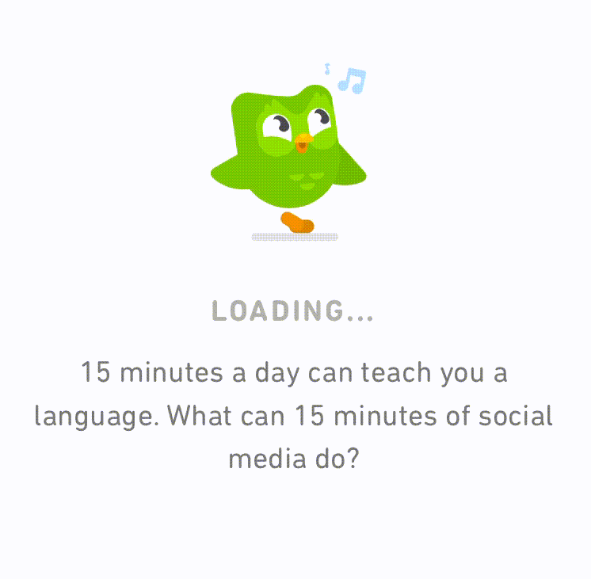

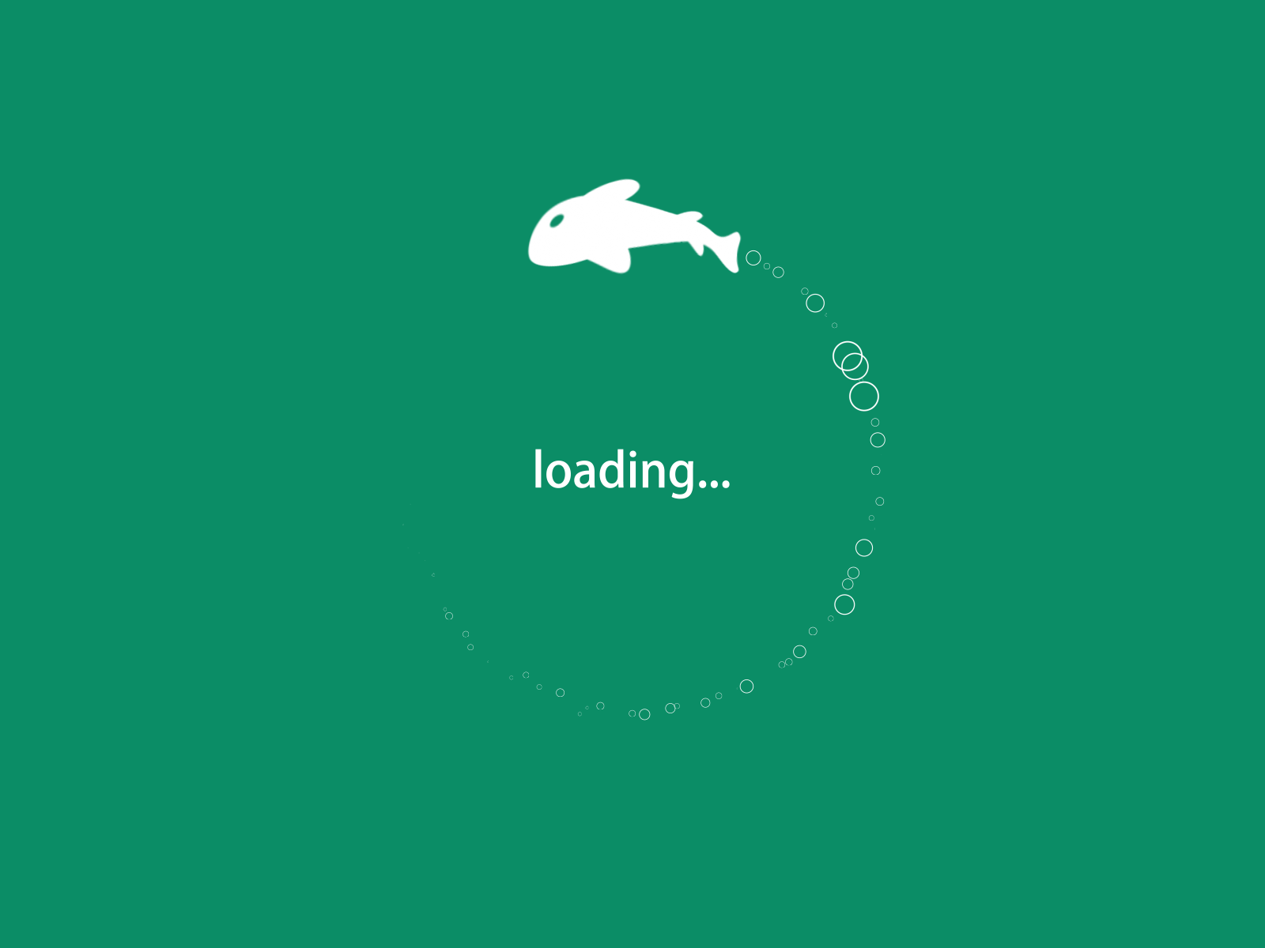
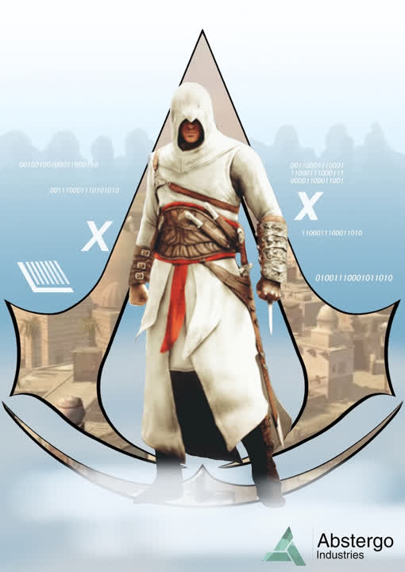
Our References

Slide 10


Methodology
Design Cool Animations: Create loading screens that don’t make users want to cry. Think spinners, progress bars, or even a dancing cat. The goal is to make waiting... almost fun.
Code It: Use some HTML, CSS, and JavaScript to make those animations move. If you’re building an app, use React Native or whatever fancy framework you like. Make it smooth, not sluggish.
Test for Performance: Don’t let your animation turn your app into a snail. Run tests to make sure the loading screen isn’t slower than watching paint dry.
Ask People What They Think: Get some feedback from real users. Do they love the animation, or do they secretly wish it would just load faster? We need answers!
Analyze the Results: Look at the data like it’s your favorite reality TV show. Who’s the winner of the best loading screen? Is it the spinner, or the progress bar with the cool gradient?
Adobe Creative Cloud
HTML, CSS, JS

Slide 11
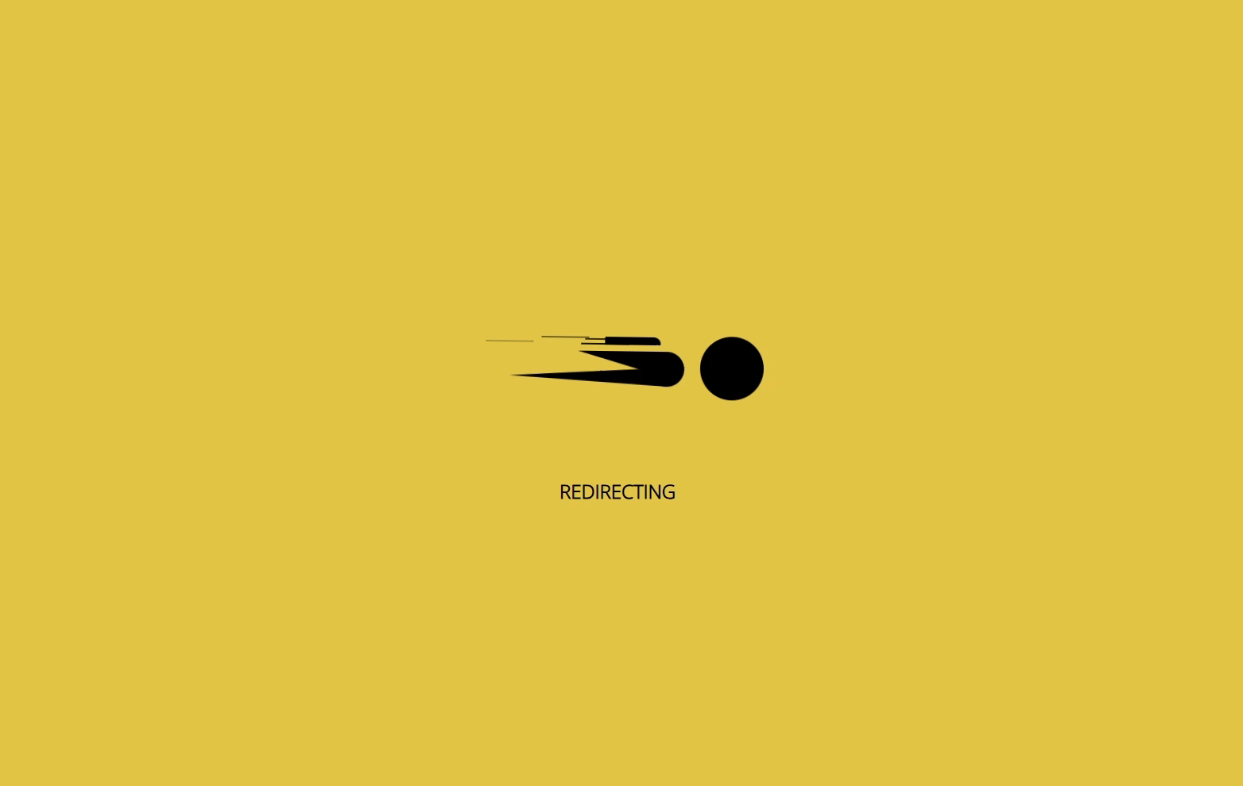

Output (Loading Page)

Slide 12
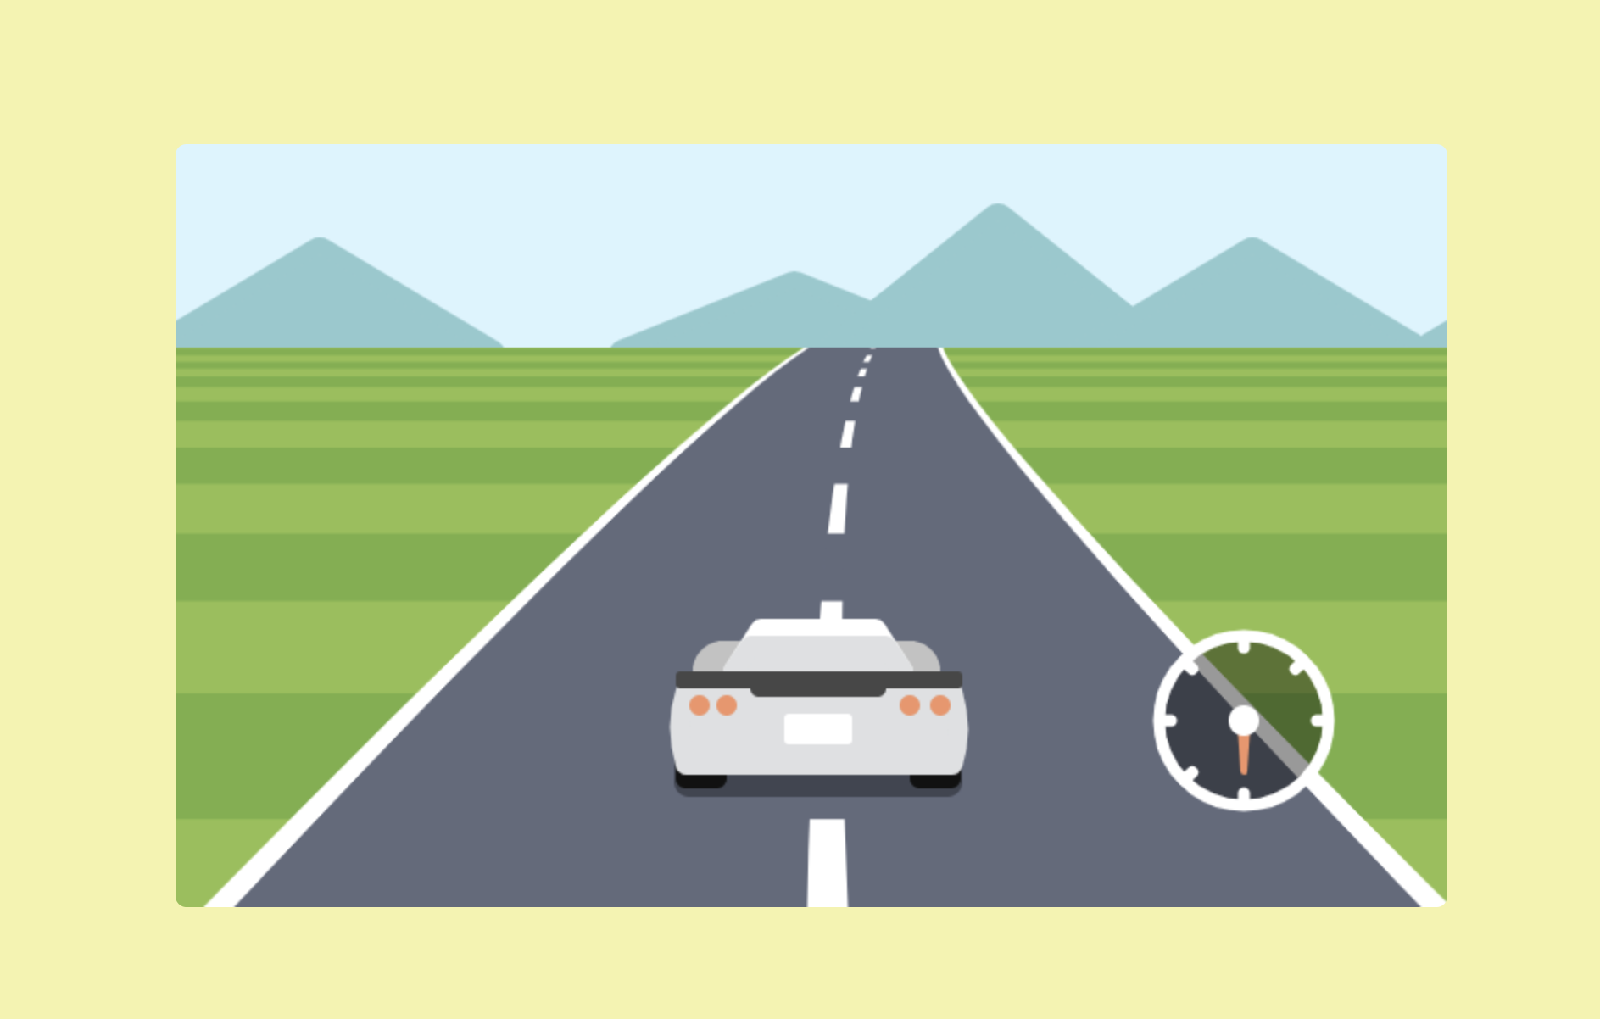
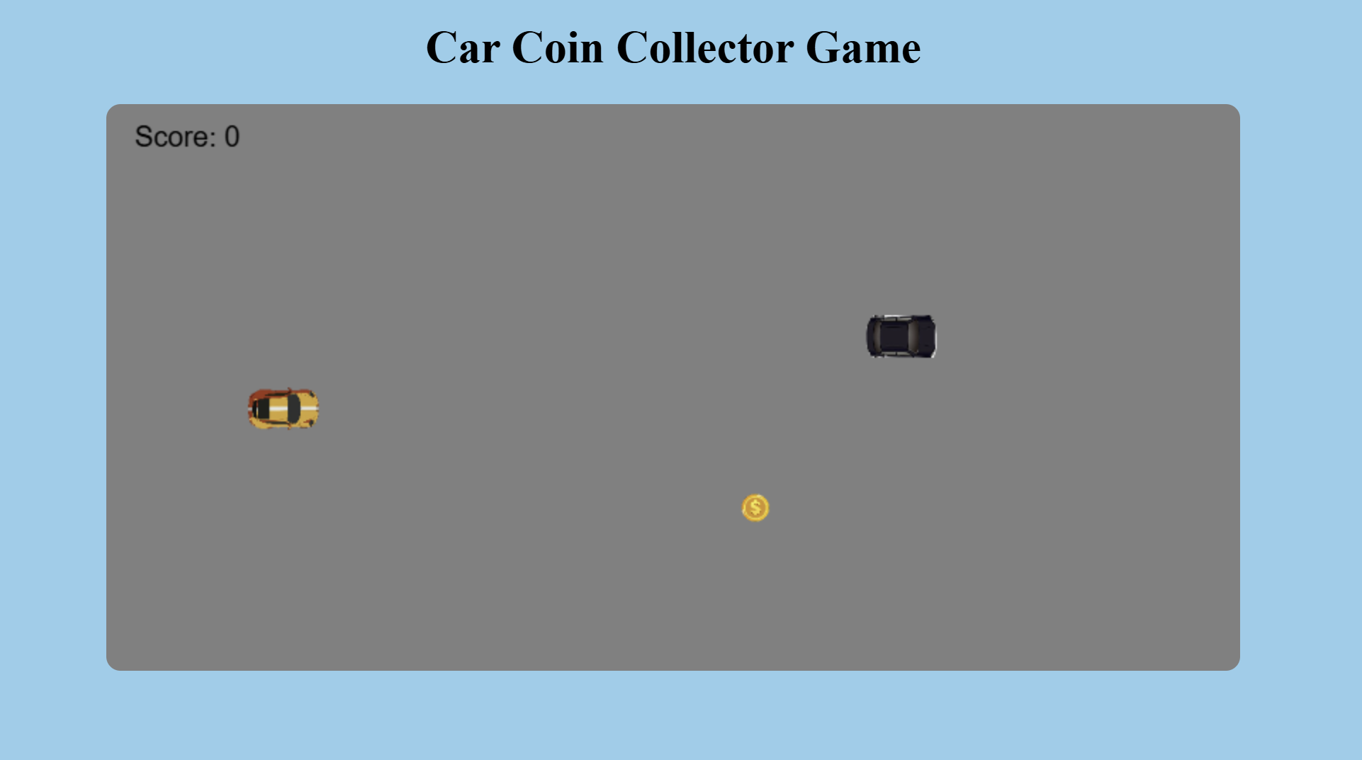
Output (Offline Game)

Slide 13

Liceria & Co.
Thank You

